Slide 1



A case study from Indian e-commerce customers
SUBMITTED BY: DILIP KUMAR

Slide 2
CONTENTS
1
Introduction
2
Overview
Let’s start the Data-Analysis.
3
Analytics of Customer Retention
4
Exploratory Data Analysis
5
Data Pre-Processing
6
Observations
7
Conclusion

Slide 3
1
Introduction
Customer retention refers to a company’s ability to turn
customers into repeat buyers and prevent them from switching
to a competitor.
It indicates whether your product and the quality of your service please your existing customers. It’s also
the lifeblood of most subscription-based companies and service providers.
Customer retention strategies are the processes and
initiatives businesses put in place to build customer loyalty and
improve customer lifetime value.
Let’s start the Data-Analysis.

Slide 4
2
Overview
Customer satisfaction has emerged as one of the most important factors that guarantee the success of online store; it has been posited as a key stimulant of purchase, repurchase intentions and customer loyalty. A comprehensive review of the literature, theories and models have been carried out to propose the models for customer activation and customer retention. Five major factors that contributed to the success of an e-commerce store have been identified as: service quality, system quality, information quality, trust and net benefit. The research furthermore investigated the factors that influence the online customers repeat purchase intention. The combination of both utilitarian value and hedonistic values are needed to affect the repeat purchase intention (loyalty) positively. The data is collected from the Indian online shoppers. Results indicate the e-retail success factors, which are very much critical for customer satisfaction.
Let’s start the Data-Analysis.

Slide 5
3
Analytics of Customer Retention
Customer retention benefits
Let’s start the Data-Analysis.
Why is customer retention important?
E-Commerce websites and Customer Retention
E-Commerce websites and Customer Retention

Slide 6
Customer retention benefits
1.Cost savings: Customer retention is generally more costeffective
than acquiring first-time customers.
•2.Positive word of mouth marketing: Loyal customers are
more likely to tell their friends and family about your
brand.
3. A better bottom line: Increasing retention rates by just 5
percent can increase revenue by 25 percent to 95 percent.
Let’s start the Data-Analysis.

Slide 7
Why is customer retention important?
Keeping your current customers happy is generally more cost-effective than acquiring first-time customers. According to the Harvard Business Review, acquiring a new customer can be 5 to 25 times more expensive than holding on to an existing one. You don’t need to spend big on marketing, advertising, or sales outreach. It is easier to turn existing customers into repeating ones, since they already trust your brand from previous purchases. New customers, however, often require more convincing when it comes to that initial sale. Customer loyalty won’t just give you repeat business. Loyal customers are more likely to give free recommendations to their colleagues, friends, and family. Creating that cycle of retained customers and buzz marketing is one way your company can cultivate customer loyalty for long-term success.
Let’s start the Data-Analysis.

Slide 8
E-Commerce websites and Customer Retention
For an e-commerce store, the customer retention rate is directly related to how much your customers trust you and how much they relish the experience of spending time on your website/app.
1.Trust.
2.Aesthetics.
3.Ease of use.
4.Clarity
Let’s start the Data-Analysis.

Slide 9
4
Exploratory Data-Analysis
We will divide the given data
1.Part-1 will be informaiton about the cutomer.
2.Part-2 will be Utilitarian Value.
3.Part-3 will be Hedonic Value.
4.Part-4 will be Precieved Risk.
5.Part-5 will be Customer Experience.
Let’s start the Data-Analysis.

Slide 10
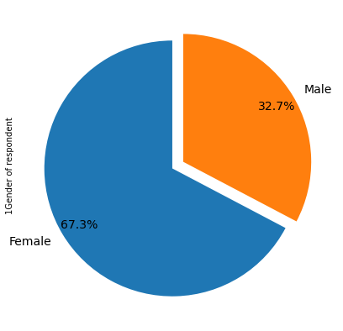
Visualising the Gender of respondent
Let’s start the Data-Analysis.

Slide 11
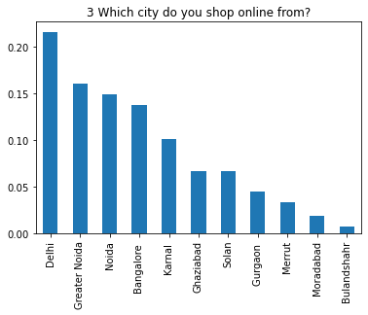
Maximum customers are from Delhi
Let’s start the Data-Analysis.

Slide 12
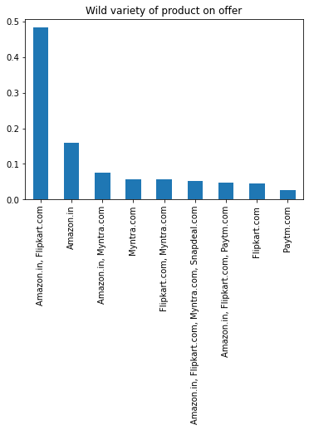
Flipkart and Amazon has wide variety of products
Let’s start the Data-Analysis.

Slide 13
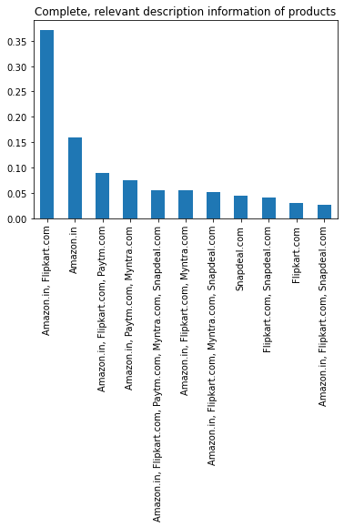
Flipkart and Amazon provide complete and relevant information about products
Let’s start the Data-Analysis.

Slide 14
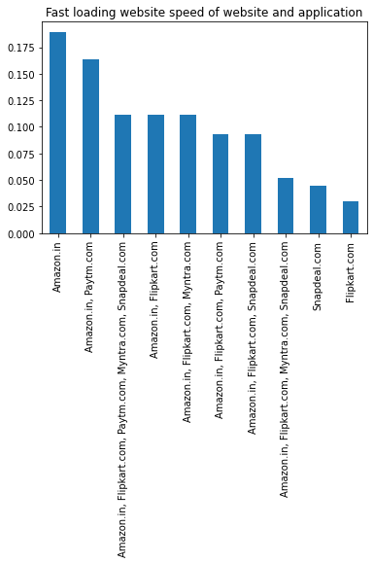
Fast loading website is Amazon
Let’s start the Data-Analysis.

Slide 15
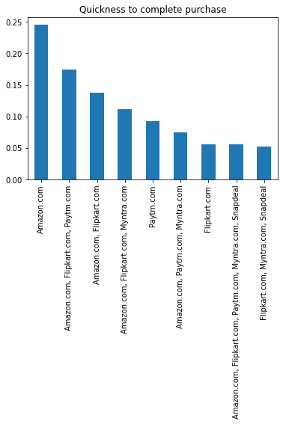
Customers can quickly purchase from Amazon as compare to other e-commerce websites
Let’s start the Data-Analysis.

Slide 16
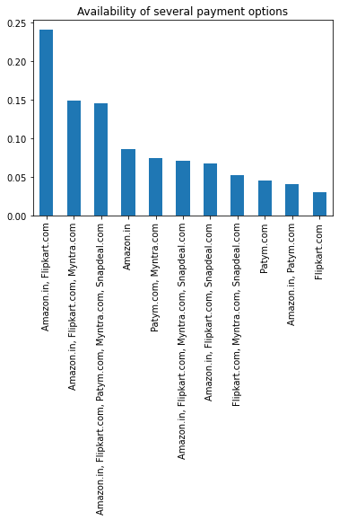
Amazon and Flipkart has wide variety of payment methods available
Let’s start the Data-Analysis.

Slide 17
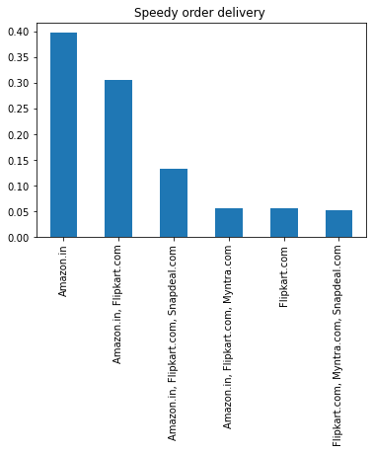
Amazon product delivery is fastest
Let’s start the Data-Analysis.

Slide 18
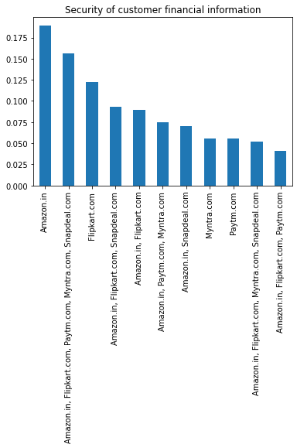
Financial security maximum with Amazon
Let’s start the Data-Analysis.

Slide 19
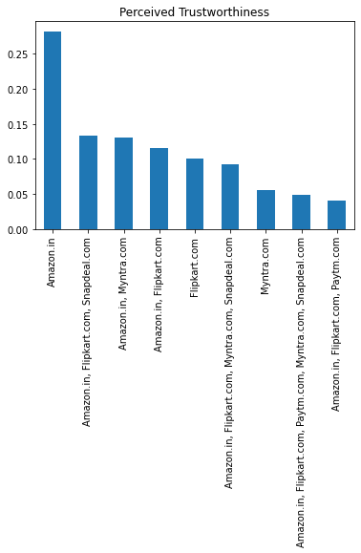
Amazon is trustworthy.
Let’s start the Data-Analysis.

Slide 20
5
Data Pre-Processing
For understanding the factors influencing the customer retention, we should consider 4 important variables.These 4 variables manipulate the 'customer satisfaction', which in turn makes the customer to stay.
These variables are:
1. Hedonic Value.
2. Utilitarian Value.
3. Precieved Risk.
4. Customer Experience.
By Analysing on the basis of these variables, we can find the basic factors influencing the 'customer satisfaction’. Thus, by
achieving the 'customer satisfaction' we can make the customer to stay and make them buy more products.
So we will do the following Analysis in 5 parts. We will use
different parts of the given data-set to help us find the customer retention factors.
Let’s start the Data-Analysis.

Slide 21
Dataset overview
• The data set is of shape (269,71) i.e. It has 71 attributes and 269 rows. The dataset is mixture of ordinal, categorical and numerical data types.
• Data contains 269 entries each having 71 variables.
• Data contains no Null values.
• We perform Extensive EDA to find out major factors that contributed to the success of an e-commerce store
• Data contains numerical as well as categorical variable.
• We will find important features which affect the trust of e-commerce customers positively or negatively.
customer retention factors.
Let’s start the Data-Analysis.

Slide 22
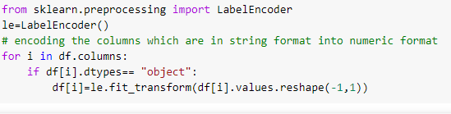
Decode categorical to Numerical values
Using Sklearn Library import LabelEncoder convert categorical values to Numerical values.
Let’s start the Data-Analysis.

Slide 23
6
Observations
OBSERVATION ON CUSTOMER INFO:
OBSERVATION ON UTILITARIAN VALUES:
Let’s start the Data-Analysis.
OBSERVATION ON HEDONIC VALUES:
OBSERVATION ON PRECIEVED RISK:
OBSERVATIONS ON CUSTOMER EXPERIENCE:

Slide 24
Observations on customer info:
1. Out of the entire participant around 67.3 %( 181 members) are women and 32.7 %( 88 members) are men.
2. 80% (230 members) of the total participants are between the age group of 21-50 years, in which 21-30 years are 79 members, 31-40 years are 81 members and 41-50 years are 70 members.
3. Participants from Delhi, Noida, Greater Noida and Bangalore seem to be shopping in higher range when considered to other cities included for the survey. This may be due to the fact that many companies and colleges are around this area.
4. Around 65% of the total participants are shopping online for more than 3 years.
5. Major part of the customers seems to be shopping less than 10 times a year.
6. Most of the customers seem to be using Smart Phone and Mobile Internet for shopping. This means the E-commerce website should be compatible in all kinds of smart phone browsers to attract a lot more customers.
7. Many used search engine to find their favorite online store, which means the E-commerce website should be search engine optimized on all times.
8. Also after the search engine, E-commerce application seems to be the second favorite mode of logging in to the website. This means the application should be server and software supported at all times.
9. Most of the participants seem to be spending an average of more than 15mins in the website for shopping.
10. Most participants desire to pay via Credit/ Debit cards while shopping online.
Enter title here
Click here to add content of the text，and brifly explain your point of view
Enter title here
Click here to add content of the text，and briefly explain your point of view

Slide 25
Observations on Utilitarian values:
1. Most of the participants strongly agree that the content on the website must be easy to read and understand.
2. Around 80% of the total customer strongly agrees that the information on similar product to the one highlighted is important for product comparison.
3. Most of the participants agree with the fact that provision of complete information on listed seller and product being offered is important for purchase decision.
4. Most of the customers expect that all relevant information on listed products must be stated clearly.
5. 90% of the customer expects a user friendly interface of the website along with ease of navigation; also they want the loading and processing speed to be less.
6. Most customers want many options for payment methods so thatthey can choose which is convenient them individually.
7. Most people expect the E-commerce website to have empathy towards its customers, they want to approach the in all platforms.
8. All the customers expect a guaranteed privacy.
9. Most customers choose online shopping because of the monetary benefit and discounts.
10. Also many enjoy the process of online shopping, when it is convenient and flexible.
11. Most customers strongly agree that return and replacement policy of the product is important for purchase decision.
12. Around 80% of the participants choose online shopping because of the wide range of category on products
Enter title here
Click here to add content of the text，and brifly explain your point of view
Enter title here
Click here to add content of the text，and briefly explain your point of view

Slide 26
Observations on Hedonic values:
1. 65% participants agree that they like the convenience of patronizing the online retailer.
2. More than half of the customers doing online shopping accept that they like the sense of adventure while shopping online.
3. Many customers don’t agree that shopping on their preferred website enhances their social status.
4. Half of the total participants say that shopping on the website helps them fulfill certain roles.
5. 90% of the customer agrees that they are getting value for money spent while shopping online.
Enter title here
Click here to add content of the text，and brifly explain your point of view
Enter title here
Click here to add content of the text，and briefly explain your point of view

Slide 27
Observations on customer Experience:
1. Most of the customers shopping on line have shopped majorly from the following websites, Amazon. In, Flipkart.com, Snapdeal.com, paytm.com.
2. Amazon, flipkart, snapdeal, myntra seems to have easy to use website or application.
3. Amazon.in and Flipkart.com has a visually appealing web-page layout.
4. Amazon.in and Flipkart.com has a wild variety of products on offers.
5. Amazon.in and Flipkart.com has complete and relevant description information of products compared to all other websites.
6. Amazon. In, Flipkart.com, Snapdeal.com, paytm.com, myntra.com has fast loading websites.
7. Amazon.in and Flipkart.com has the reliability of the customer.
8. Amazon.in, Flipkart.com has quickness towards completing the purchase.
9. Amazon. In, Flipkart.com, Snapdeal.com has availability of several payment options.
10. Amazon.in and Flipkart.com has speedy order delivery.
11. According to customers the privacy and security of customer financial information is maintained by Amazon.in and Flipkart.com.
Enter title here
Click here to add content of the text，and brifly explain your point of view
Enter title here
Click here to add content of the text，and briefly explain your point of view

Slide 28
Observations on customer Experience:
12. Amazon. In, Flipkart.com, Snapdeal.com has a Perceived Trustworthiness.
13. Presence of online assistance through multi-channel is mostly provided by Amazon.In, Flipkart.com, and Snapdeal.com.
14. Longer time to get logged in (promotion, sales period): Amazon.in, Flipkart.com, Paytm.com.
15. Amazon.in, Flipkart.com, Myntra.com, Snapdeal.com takes longer time in displaying graphics and photos.
16. Myntra.com, Paytm.com, snapdeal.com has a practice of late declaration of prices.
17. Myntra.com, Paytm.com, snapdeal.com, Flipkart.com has a longer page loading time (promotion, sales period).
18. Amazon.in and snapdeal.com has limited mode of payment on most products.
19. Paytm.com, snapdeal.com, Flipkart.com has a longer delivery period.
20. Amazon.in, Paytm.com has regular change in website/application design.
21. Amazon.in, Myntra.com, Snapdeal.com, Paytm.com has frequent disruption when moving from one page to another.
22. Amazon.in and Flipkart.com Website are as efficient as before.
23. Amazon.in and Flipkart.com seems to be the most recommended Indian online retailer website.
Enter title here
Click here to add content of the text，and brifly explain your point of view
Enter title here
Click here to add content of the text，and briefly explain your point of view

Slide 29
Observations on Preceived Risk:
1. Many people abandon their shopping cart due to factors such as better alternative offer, promo code not applicable, change in price, lack of trust, and no preferred mode of
payment.
Enter title here
Click here to add content of the text，and brifly explain your point of view
Enter title here
Click here to add content of the text，and briefly explain your point of view

Slide 30
7
Conclusion
The purpose of this study is to understand the influence of utilitarian
values, hedonic values, customer experience and perceived risk on Ecommerce customer satisfaction in India.
The analysis shows that the Utilitarian Value significantly influences
Customer Satisfaction, meaning that the level of Utilitarian Value of ecommerce customers will affect the level of Customer Satisfaction. In
other words, the better (higher) Utilitarian Value given by e commerce products will lead to satisfaction with customers.
Hedonic Value significantly influences Customer Satisfaction, meaning that the high and low Hedonic Value of e-commerce customers will affect the level of Customer Satisfaction. In other words, the higher the Hedonic Value given by e-commerce products will lead to the satisfaction of ecommerce customers.
Let’s start the Data-Analysis.

Slide 31
THANK YOU
SUBMITTED BY: DILIP KUMAR

